Slide 1
Roadmap en update
Mitel User Group
Frits Wilmink
21 November 2019

Slide 2
MiVoice Business Roadmap view
MiVB 9.1
MiVB in a Docker container with Kubernetes orchestration for MiCloud Flex in GCP
AX Controller integration
SIP-DECT Provisioning Simplification
Multicast support
Dial out of queue for Ring Groups
MiVoice Business Console with CloudLink chat
MiVB 10.0
Call History Consolidation
Maintain callback position in queue and last agent routing for ACD
Updated MiVoice Business Console
Full LDAP support
New SMB platform
Increased capacity to 15000 endpoints
MiVB 9.0
Software refresh
EX Controller
Caller ID based routing
Last Agent Recall
Q4’18 | Q1’19 | Q2’19 | Q3’19 | Q4’19 | Q1’20 | Q2’20 | Q3’20 | Q4’20
MiVB 9.0 SP3
6905, 6910 and 6970 conference set introduction
MiVB 9.1+
Container support for private cloud
GA
In Progress
In Planning
Directional

Slide 3
MiCollab Today
1.6M+
USERS
IN 100+
COUNTRIES
1.3M
MICOLLAB USERS UNDER ACTIVE SWA
MORE THAN
7700
SYSTEMS UPDATED TO MICOLLAB 8+
POWERS
ALL UC PLATFORMS
MiVoice Business, 5000, 400 and MX-ONE
>420K
32.5%
ATTACH RATE YTD
vs 31.8% in 2018
USERS SHIPPED
Last 12 Months

Slide 4



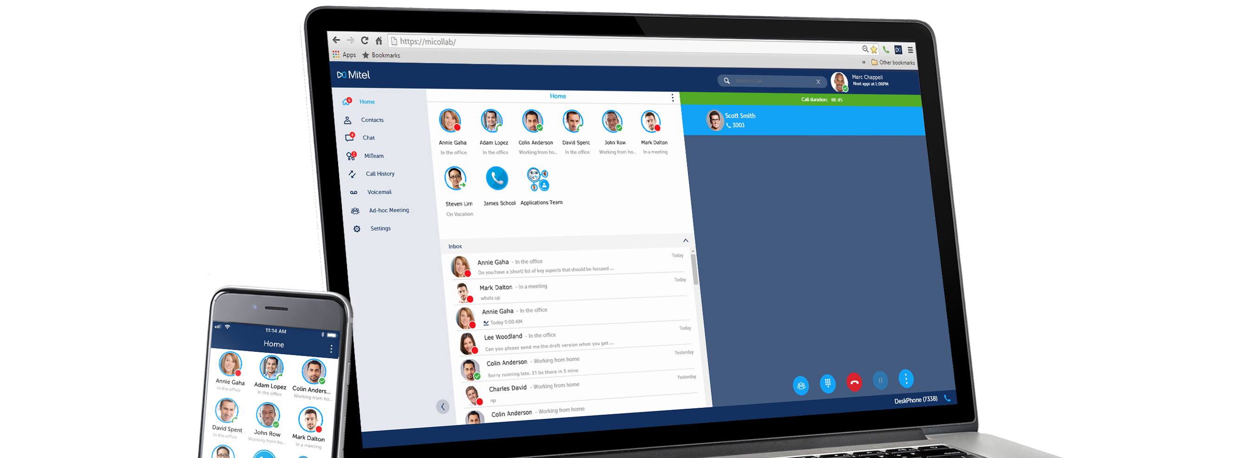
MiCollab – Release 9 Main Enhancement Themes
ENHANCED USER
EXPERIENCE
A connected collaboration experience across communications channels and devices
IMPROVED PRIVACY
CONTROL
Next generation UCC software coupled with next generation deployment options for your
peace of mind
DESIGNED FOR THE
FUTURE
Introducing enhancements to future proof your UCC solution and accelerate new feature / capability introduction
Notes:
There are three main pillars of enhancements for the MiCollab with the upcoming introduction of Release 9.0 software, including:
The End User Experience of MiCollab – in particular with the desktop client
Enhancing the privacy of users
Expanding the ability for MiCollab to address the needs of organizations today and in the future – in particular when it comes to accelerating the ability for Mitel (and MiCollab) to introduce new features and capabilities for our customers

Slide 5
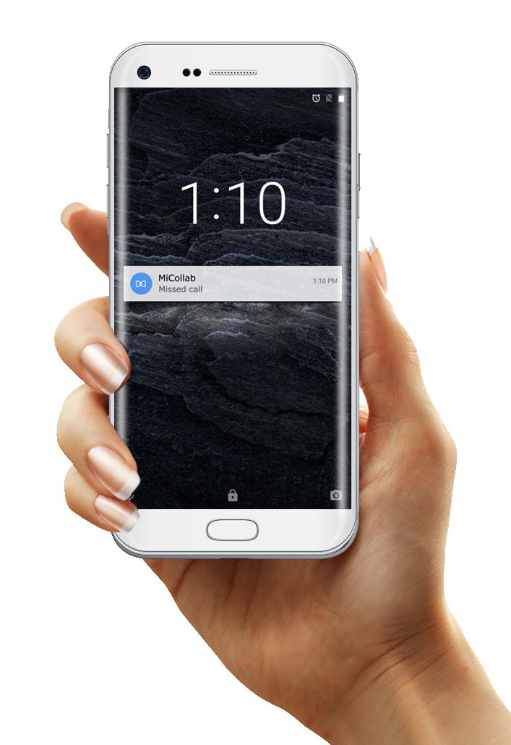
Android Client Enhancements
Push Notifications
  Similar to MiCollab for iOS, the Android client now supports push notifications
    Delivery of messages to device even if MiCollab is in the
    background / not running
    Removes keep alive signaling
    Saves on battery life / performance
Android Connection Services (Android 9 and higher)
  Improved handling of call multiple calls
    Calls on GSM and softphone interactions
  Improved Bluetooth headset integration
Notes:
Several MiCollab releases ago, support for Apple Push Notifications and iOS CallKit were introduced into MiCollab to enhance the mobile user experience on the iPhone. MiCollab Release 9.0 now adds similar support for Android-based users to enhance their mobile MiCollab client user experience.
This includes support for Android’s push notification service, which in turn will greatly enhance the mobile user experience by ensuring calls or chats are no longer missed due to the client running in the background. With support for Push Notification (APN) service MiCollab will receive the following notifications:
Incoming Calls
Chats
Missed Calls
New Voice Mail
For example: When a MiCollab calls comes into the device Push Notification support brings the MiCollab application in foreground so that the Softphone can be registered and able to handle the incoming call.
Furthermore, support for the Android’s Push Notification service will also improve battery consumption, as the MiCollab client no longer needs to stay continuously registered with the server in order for notifications to be active/received
MiCollab Release 9.0 also introduces support for Android Connection Services - the Android equivalent of iOS CallKit- for Android-based devices running Android 9 (otherwise known as Android Pie) or higher . Support for Android Connection Services provides users of MiCollab mobile client for Android with a choice of how to manage multiple calls, in particular when they are on a MiCollab softphone based call and a second GSM (or cellular-based) call comes into their device, plus enables proper headset button controls on Bluetooth devices enabling Answer, Hang up, Mute, and Volume Control.
NOTE: Phones with earlier software versions will continue to work as they do today​
NOTE: Dialing MiCollab contacts from native dialer is not supported due to Android’s implementation of their Connection Services. They do are not offer 100% the same hooks as Apple’s iOS CallKit.

Slide 6
MiCollab Roadmap
MiCollab 9.0
Cloud based Chat
MSL 11
SW Download Center
Android push notification
Android Connection Service
Presence Privacy
AWV 2-way Web audio
UI Enhancements
MiCollab 9.1
Nuance 11
Dynamic Status routing
15 digit numbering
MiCollab 1H2020*
Focus on prioritized customer requirements
  Admin controls (Outbound CLI)
  Ring/Hunt-groups & call pickup enhancements
Next Generation MiTeam (CloudLink based)
Docker Containers for FLEX in GCP
Improvements for Embedded Voicemail (to support containers)
Q2’19 | Q3’19 | Q4’19 | Q1’20 | Q2’20 | Q3’20
MiCollab 2H2020*
Focus on prioritized customer requirements (DFR backlog)
New user authentication architecture
Improve large customer deployments
MiCollab 9.1.2 (Client)
MiTeam Meeting (cross launch)
Topic based chat (MiTeam Streams)
Usability
* Release contents subject to change
Committed
In planning
Indicative
Notes:
Additional 9.1 features
Opt-out of Analytics
Delete Call History entries
Support of 15-digit number plan
Dynamic Status routing on No Answer and Busy (currently not available on MX-ONE)
Executed dialing with call-to in the background without user interaction with the client

Slide 7
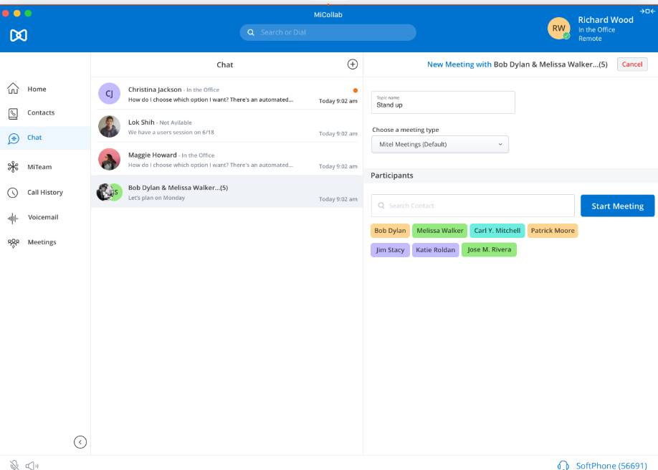
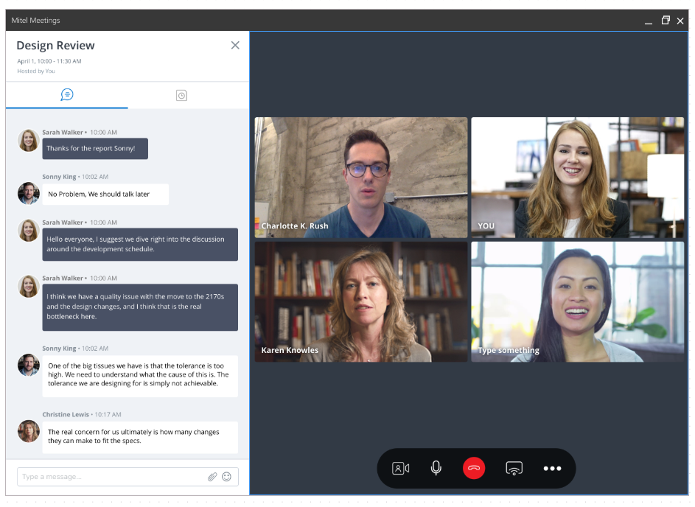
Escalate from MiCollab into a Video Meeting
Notes:
From a group chat in MiCollab cross-launches a meeting in MiTeam Meetings.

Slide 8
MiCC Business 9.2
  Contact Center Messenger
  Google Contact Center AI – Virtual Agent and Agent Assist
  MiVoice Connect support
  Other Enhancements
    Teleopti WFM support for MiContact Center Business for SIP
    Amazon Corretto SE8 for JAVA support
    MiContact Center Outbound enhancements

Slide 9

CONTACT CENTER MESSENGER
Next-gen cloud chat platform leveraging common CloudLink Chat APIs used in MiCollab chat
Rich customer self-service and live assisted interactions, leveraging Google Contact Center AI for Virtual Agent and Agent Assist
Replaces the legacy Web Chat solution as the strategic go-forward messaging solution
Notes:
and will provide the basis for future SMS and social media messaging support.

Slide 10
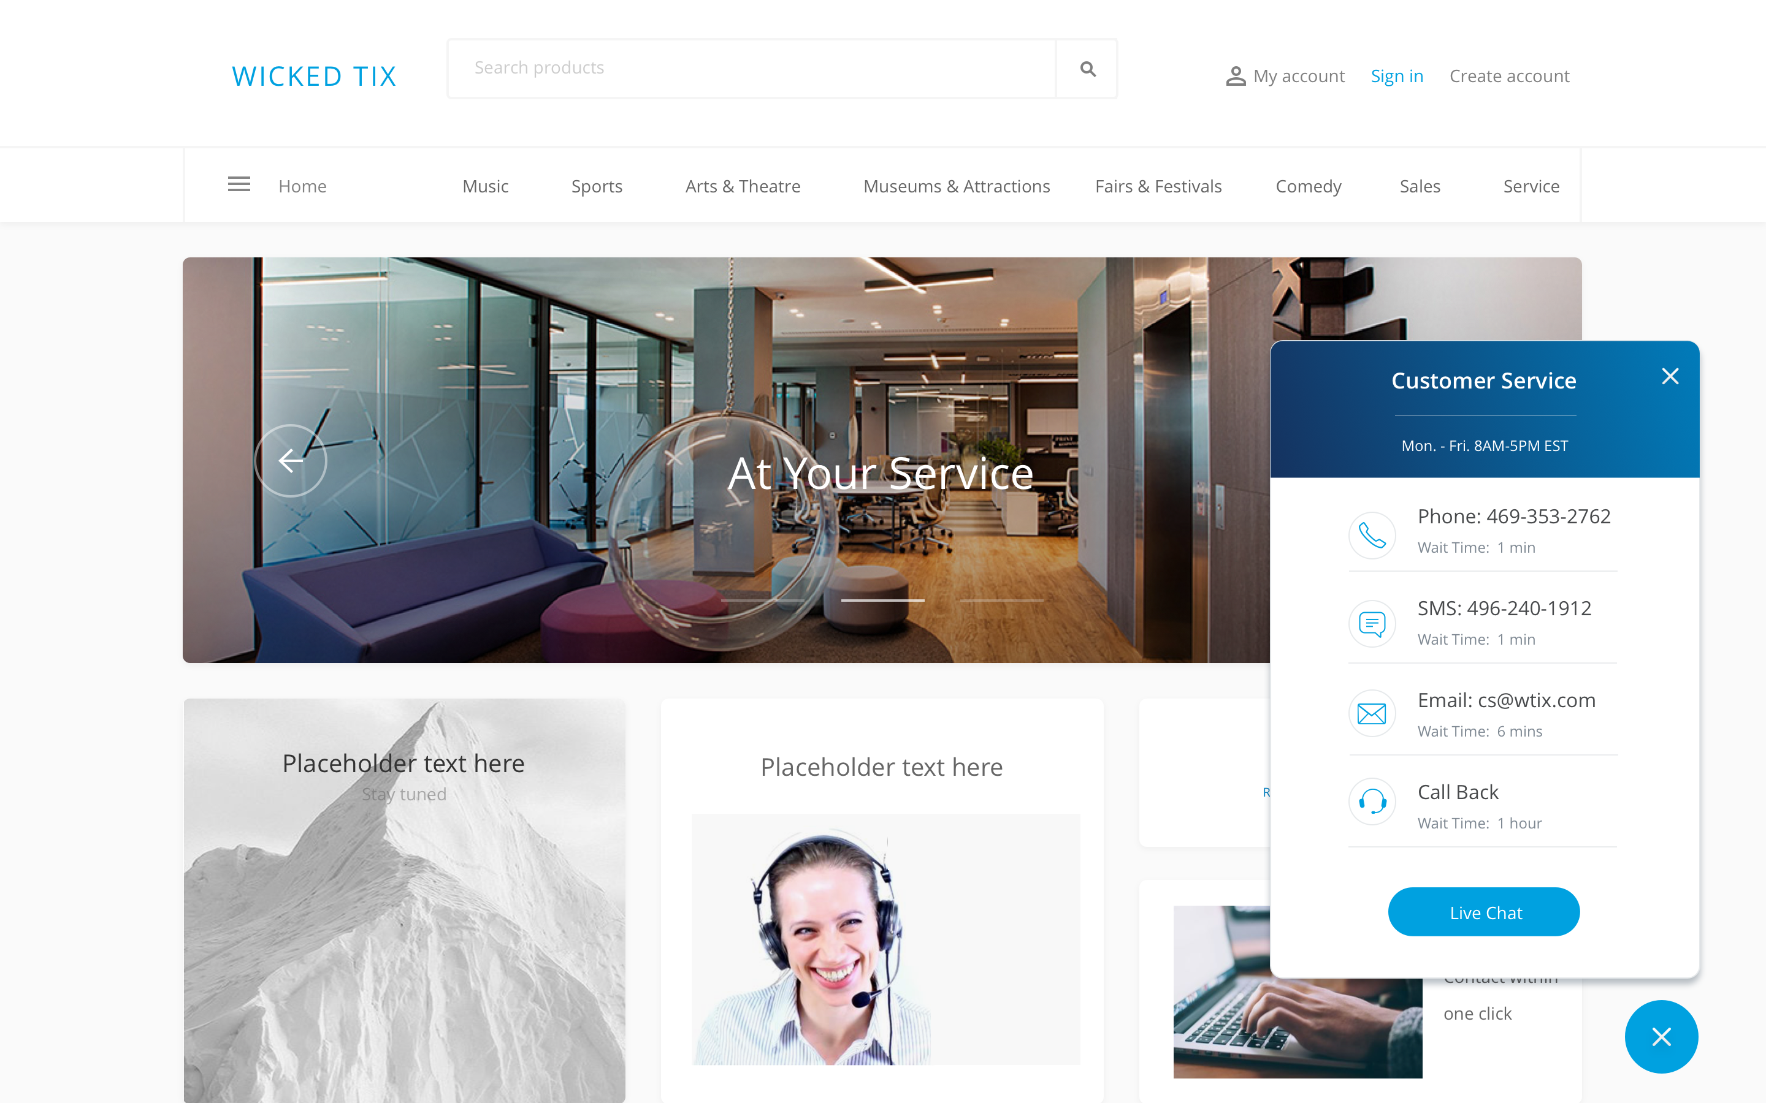
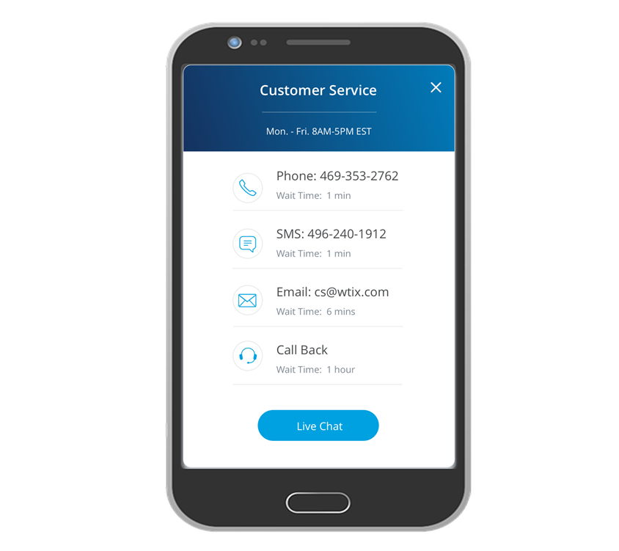
Contact Center Messenger

Slide 11

Waarom een cloud dienst afnemen?
  Acceptatie cloud diensten
  Lage maandelijkse kosten
  1 aanspreekpunt
  Innovatie / nieuwe diensten
  Hoge beschikbaarheid
  Schaalbaarheid

Slide 12










Evolution of serverless architecture
Microservices
(CloudLink)
1
S
V
AI
V
III
A
I
B
Z
Containers
Virtual Machines
Server

Slide 13










The Building Blocks of Our Future
Call Control
Collaboration
Contact Center
Analytics
Mobility
1
S
V
AI
V
III
A
I
B
Z
Applications
CloudLink
Containers
Cloud Partners
Notes:
What do we want to obtain?
FASTER
LESS EXPENSIVE
INSTANTLY
EFFICIENT
GLOBALLY

Slide 14
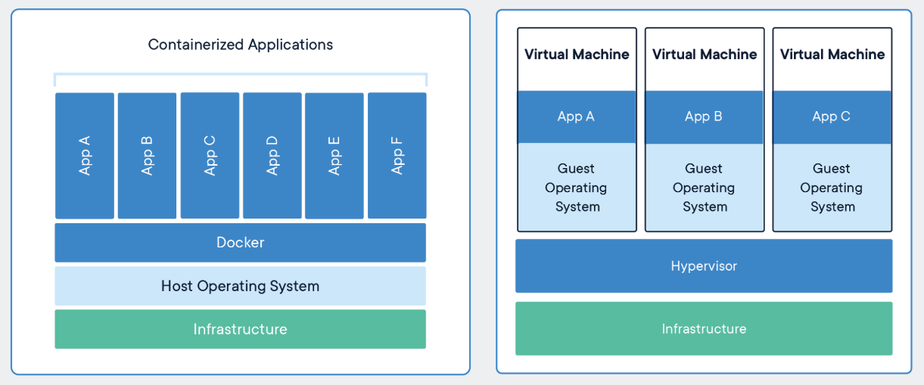
Let’s Talk Containers
me
Containerization is een manier om applicaties te bundelen met de afhankelijkheden van de applicatie zodat deze op een public cloud kunnen draaien
Notes:
FLEX VIA GOOGLE STORE _> 10 min
Simplify
Partnerbuild was to complex.
Mivb to linux: first step
Easy to buy and deploy: example JFS
SCALABLE
Data centre spend (private) is dropping with 15-20% per year, this is what happening and that’s why public is growing, the dramatic shift will happen in between 2020 and 2023.
NEIL Woodcock : containerization

Slide 15


De voordelen van containerization
Containerization in de public cloud
Lagere kosten
Onbeperkt schaalbaar
Security
Integratie met andere cloud diensten

Slide 16


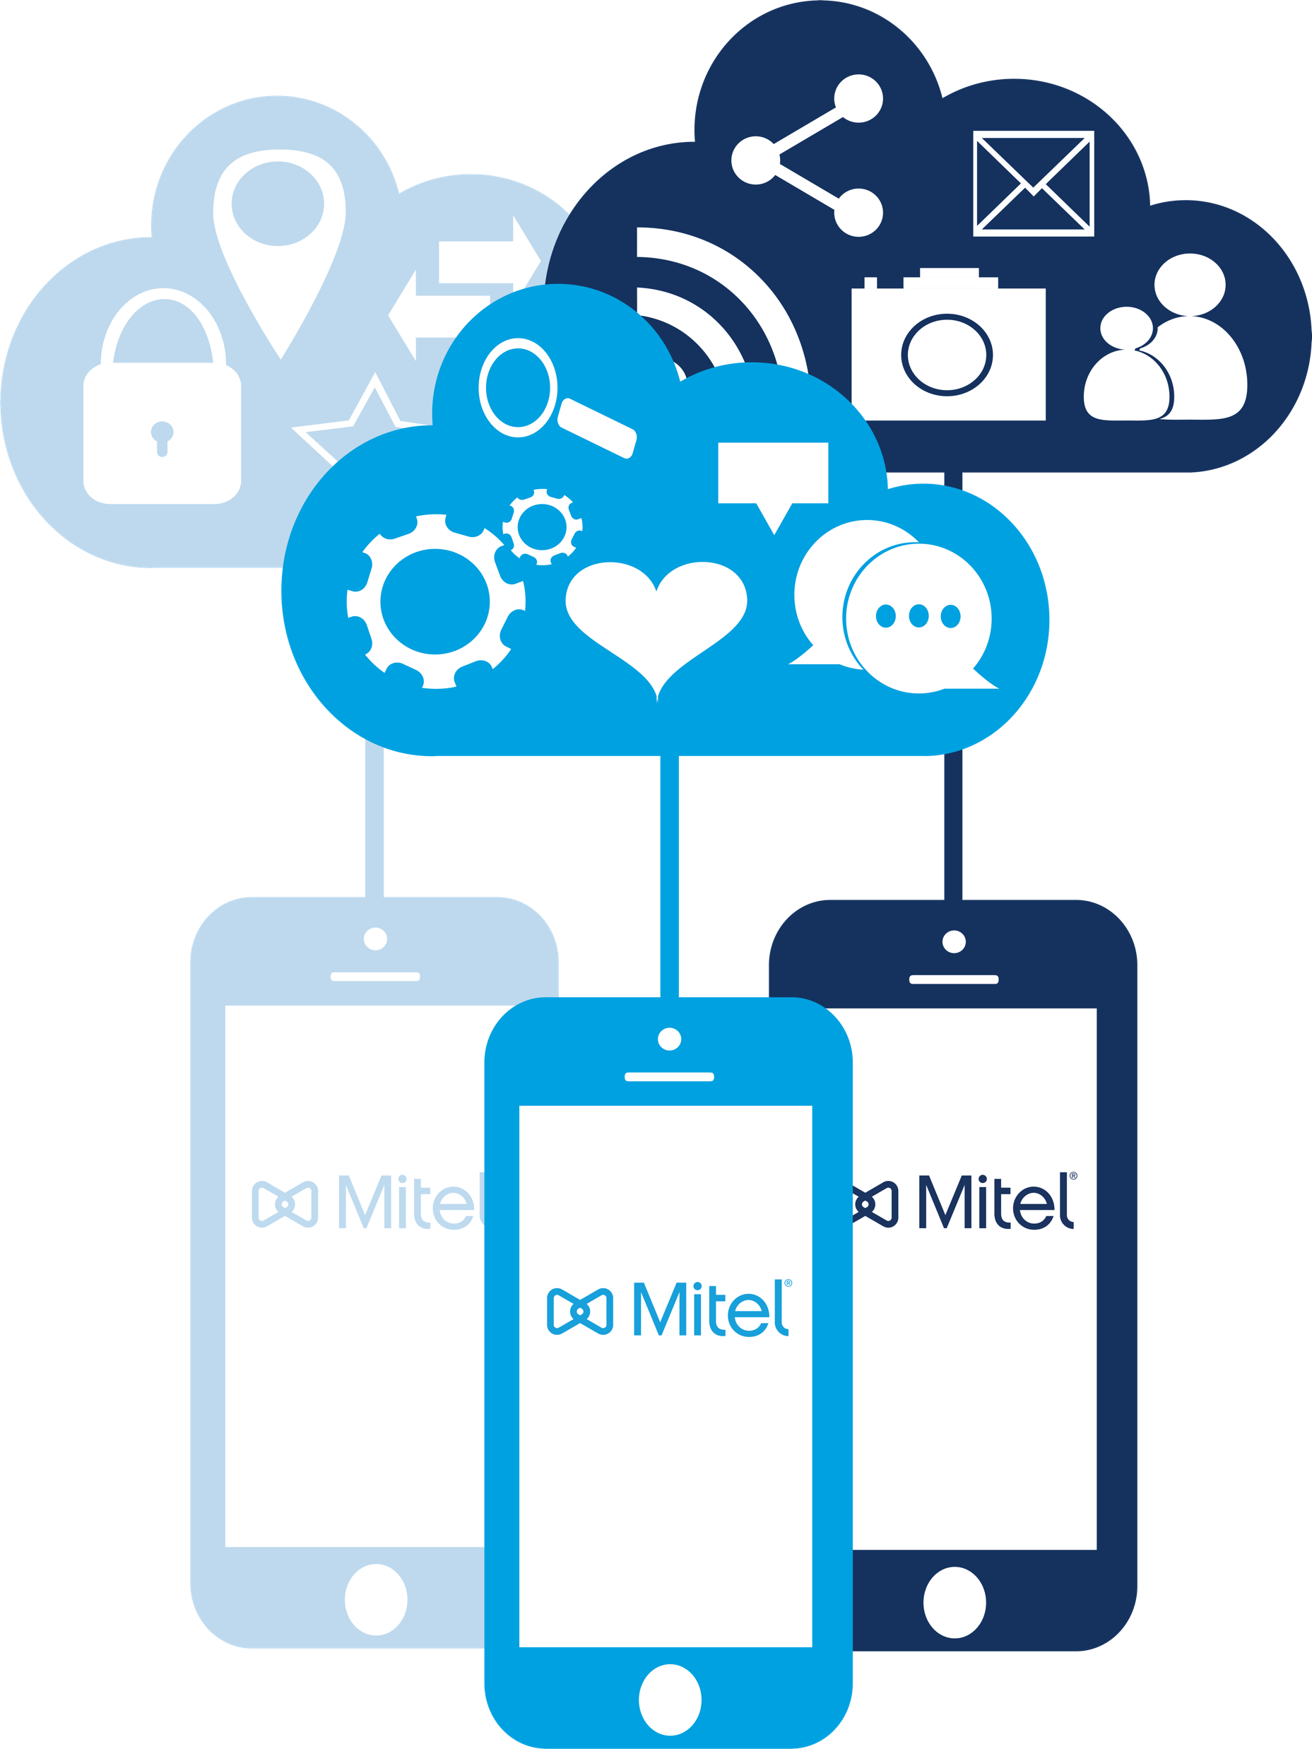

Mitel CloudLink – Cloud enabled apps for onsite platforms
Mitel CloudLink
CloudLink Gateway
CloudLink Platform
CloudLink Applications
Notes:
Mitel CloudLink is a strategic asset….it’s a service comprised of 3 main components…the Mitel CloudLink Gateway, native cloud platform and advanced applications.

Slide 17
Thank you

