Slide 1

Portfolio and Roadmap Update
Wesley de Roode
November 2021
Notes:
Let me talk tell you what are major drivers are 1. large install mid-market base 2. partner-first 3. cloud accessibility across the entire portfolio

Slide 2
Intro
Micollab MiVB roadmap
Mitel One /CX
Revolution
Mitel en MS Teams

Slide 3
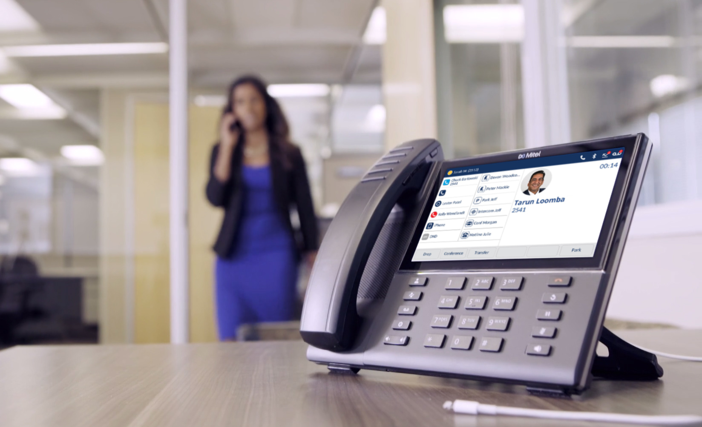
MiVoice Business
MiCollab
Roadmap

Slide 4


MiCollab – in cijfers
Powers
>2,000,000
MiCollab users
Mitel’s Call Control Platforms
MiVoice Business, 5000, 400
and MX-ONE
9,750 systems
have been updated
to MiCollab R9
>200K
users shipped annually
5

Slide 5
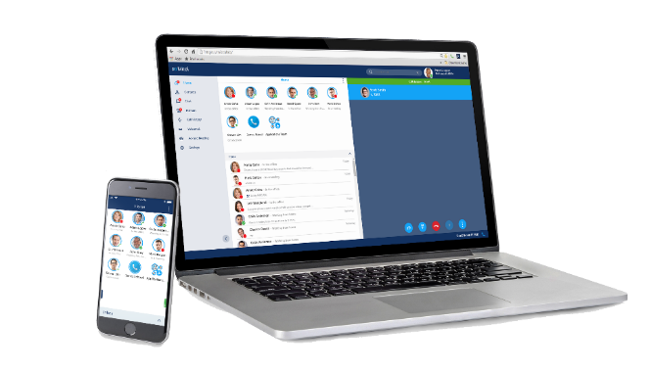
MiCollab Roadmap
Single point for communications and collaboration to enhance the effectiveness of every interaction
MiCollab 9.3 (1H 2021)
    Azure AD Authentication
    Centralized Management
    Flexible CLI for MX-ONE
    Group Presence
    Group Chat Enhancements
Notes:
Some of the key aspects MiCollab provides includes:
Presence: of others enabling you to know whether the person you need to connect with are on their phone, away from their desk or available for a chat via text
Point of access to the directory of all employees with point and click or tap and hold communications
Access to one-to-one, group and persistent messaging for when a quick question or comment via instant messaging is the right choice in the moment
The ability to share information and coordinate work on projects regardless of location / device and the escalation of a voice call or chat to a web and video collaboration session
And a streamlined workflow between Outlook and core communications with support for a range of integrations, including email access from with their MiCollab client, the creation of MiCollab conferences from within their Outlook calendar, and access to Chat and voice calling from Outlook Contact Cards

Slide 6
MiCollab – Planned Releases and Directional Roadmap
MiCollab 9.4 (GA Nov.)
Compliance / TCO
  RAY BAUM’s Act
  Azure SSO – UPN (non email format)
  importing Contacts when CloudLink user provisioning is used
Voice & Telephony
  Improved number info for group calls (MX-ONE, MiV5000)
  WebRTC improvements
  Usability
  Improved Audio Device Handling
  Integration
  Use with Mitel Assistant for MS Teams
MiCollab 9.6 Directional
Voice & Telephony
  More robust mobile softphone (LTE/WiFi)
  Control Ring groups in Dynamic Statuses
Usability
Accessibility
Compliance / TCO
  More flexible deployment options (AWS, Azure)
  Support of other Identity Providers
Integrations
  CloudLink APIs
Security
MiCollab 10.0 - Directional
Voice & Telephony
  WebRTC capacity improvements
  Self Service administration & analytics
Usability
Siri & Car integrations
Compliance / TCO
  Deploy what you use and save cost
  Improved upgrade downtime
Integrations
Security
2H’21 | 1H’22 | 2H22 | 2023 and Beyond
MiCollab 9.5
Voice & Telephony
  Login/out if Ring groups – MX-ONE & MiV5000
  Call Pickup MiVB
  Improved call history
Usability
  Mobile client enhancements
  Headless client for MS Teams
Compliance / TCO enhancements
  Increased capacity (50 000 users)
Security
  Secure CSTA with MX-ONE
MiCollab 9.4 SP1
Compliance / TCO
  RAY BAUM’s Act – Intrado
  Windows 11
Security
  Security Guidelines
GA
In Progress
In Planning
Directional
Notes:
Import Contacts from CSV
MiCollab Client Audio selection (that sticks)
WebRTC Hold & Supervised Transfer

Slide 7
Mitel One/CX

Slide 8

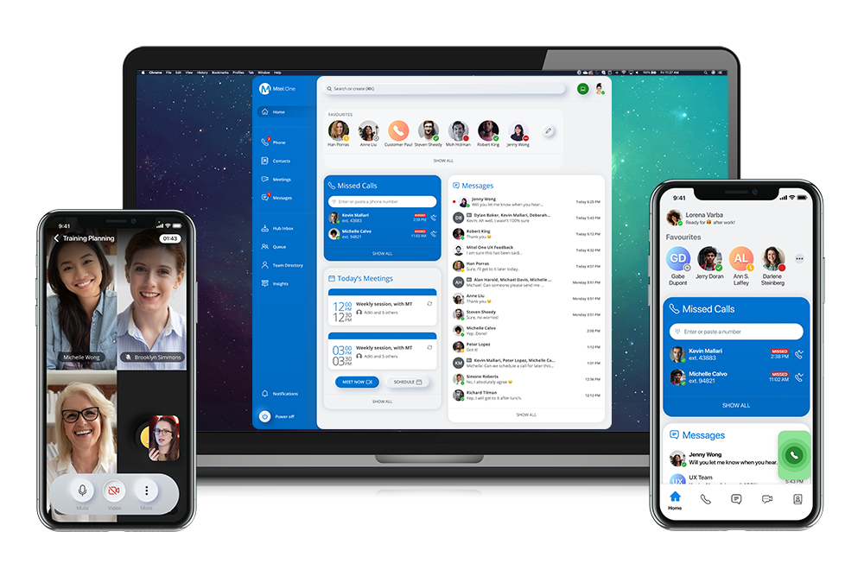
MITEL ONE
ONE APP FOR
ALL OF MITEL
Notes:
Narrative: Mitel One unifies telephony, meetings, collaboration and contact center into a modern, easy to use employee interface. Mitel One is the only solution on the market that combines the employee and customer experience into a single user interface. Mitel One is a game changer that will catapult Mitel to greater heights beyond what any of our competitors offer. Mitel One will become the single client for all Mitel communication platforms.

Slide 9

Get Everyone on the Same Page
  One app for all communications helps everyone share information more effectively
  Every employee can have meaningful interactions internally and with customers
  Have confidence your employees are productive no matter where they are
Personalized Communications
  Customizable widgets prioritize what’s most important to you
  There is no “One size fits all” approach to getting work done
Connect Easier
  Information at a glance, no switching back and forth
  Connected when you work, not when you’re off
  Intuitive design means no training videos required
Notes:
Widget dashboard ​
The simplicity of rich visual widgets, where bits of core information from very different sources, can be co-presented, arranged and interacted with directly in a dashboard style UI has proven effective, and is becoming more common.
(Short term differentiator – other apps are following)
Modern UI
Our UI direction, Neumorphism, combines elements of flat/ minimalist design and skeuomorphism. This achieves a layered, soft, almost moulded plastic look, contrasting a very flat and at times dull UI of many competitors.
Dark Mode. If dark mode is not already expected, it will be shortly as most OS’s have introduces dark mode.
(Short/midterm differentiator)
Simple agenda builder
The is one of the top take away’s from our NA/EU research with Frog Design. Since then, the number of meetings we are in have exploded but more often than not we meet around a “Meeting Title” only, with no other information. The research readout suggests a shared meeting agenda that will invite a more precise discussion Before, During, After​ a meeting.
(Short/mid/long term differentiator if the concept has traction and we keep building it out)
Device awareness​​
In my mind one of the absolute biggest differentiators we have up our sleeve. If Mitel devices around us are aware of our proximity, magic can happen. As an example, you no longer have to fiddle with video, in room displays or conference units when setting up a meeting room. All these connections now happen while you bring up your presentation.
We, and none of our competitors have a seamless solution. Yet before the pandemic, one of the biggest complaints from users and customers was the time it takes to set up meeting room. This was confirmed through the Frog research. Noting will be released on 2021 so probably needs to be kept out of GKO though.
(Long term differentiator)
Light External Communication
Darren explained the seamless and super powerful blend of UC and light CC functionality perfectly.
(Short/mid/long term differentiator if we keep building it out)
Start/Stop Work​ (Not CC)
Users are looking for better defined borders around work. Particularly during the pandemic, these borders are blurring. On/Off work allows a user to “leave” work and let own preferences handle the conversation after hours.
(Short/mid term differentiator – Easy to copy if there is traction)
Micro View (Not CC)
The OneApp Micro View is a matchbox sized UI that can be tugged away in a corner of the monitor while still visually tracking and alerting the user of activities.
(Not really a differentiator. Other have smaller UI’s but nothing this discreet.)

Slide 10
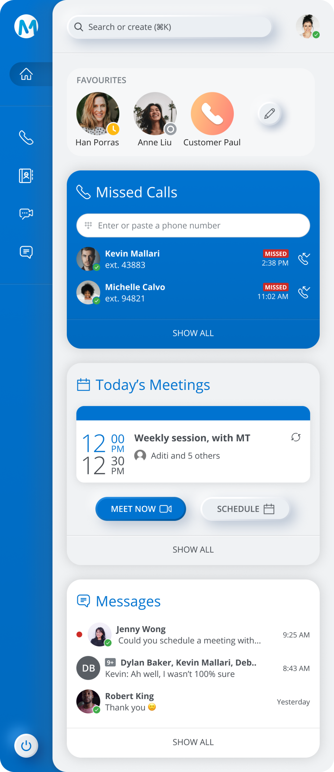
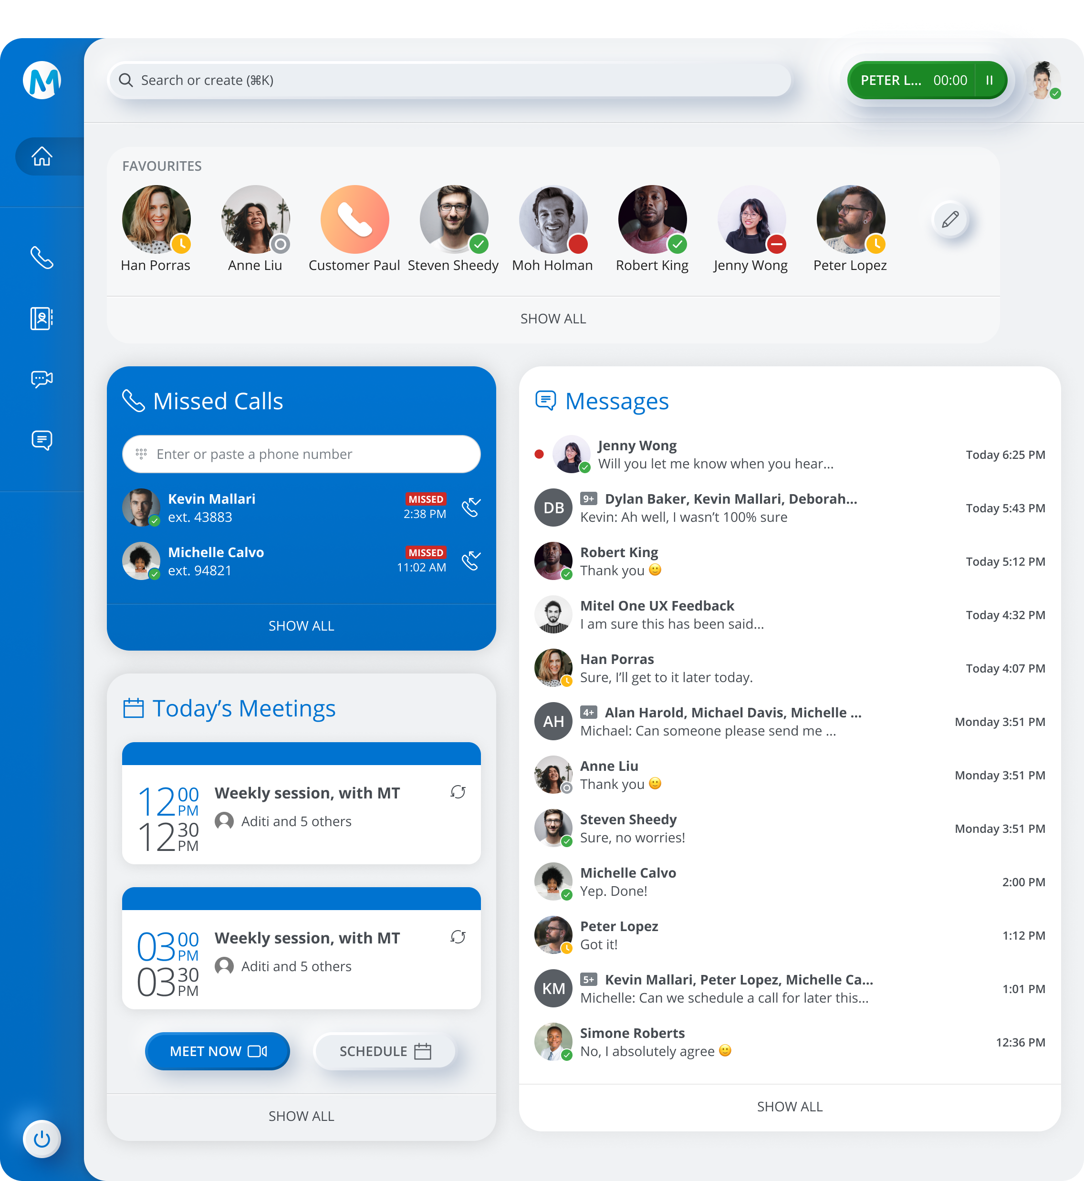
Mitel One Home Dashboard All-in-One Collaboration Suite
Global Search
Phone
Meetings
Messages
On/Off Work
*All screenshots are mockups. Actual application views may differ from what is shown.

Slide 11
Key Differentiators
Global Search
Device awareness
Recent contacts
Modern UI
Widget dashboard
Simple agenda builder: Before, During, and After meeting
Device awareness and integration
Auto populate contacts
Start/Stop Work
Light/Dark mode
Mini View
CX feature set
Phone
Meetings
Messages
On/Off Work
Notes:
Widget dashboard ​
The simplicity of rich visual widgets, where bits of core information from very different sources, can be co-presented, arranged and interacted with directly in a dashboard style UI has proven effective, and is becoming more common.
(Short term differentiator – other apps are following)
Modern UI
Our UI direction, Neumorphism, combines elements of flat/ minimalist design and skeuomorphism. This achieves a layered, soft, almost moulded plastic look, contrasting a very flat and at times dull UI of many competitors.
Dark Mode. If dark mode is not already expected, it will be shortly as most OS’s have introduces dark mode.
(Short/midterm differentiator)
Simple agenda builder
The is one of the top take away’s from our NA/EU research with Frog Design. Since then, the number of meetings we are in have exploded but more often than not we meet around a “Meeting Title” only, with no other information. The research readout suggests a shared meeting agenda that will invite a more precise discussion Before, During, After​ a meeting.
(Short/mid/long term differentiator if the concept has traction and we keep building it out)
Device awareness​​
In my mind one of the absolute biggest differentiators we have up our sleeve. If Mitel devices around us are aware of our proximity, magic can happen. As an example, you no longer have to fiddle with video, in room displays or conference units when setting up a meeting room. All these connections now happen while you bring up your presentation.
We, and none of our competitors have a seamless solution. Yet before the pandemic, one of the biggest complaints from users and customers was the time it takes to set up meeting room. This was confirmed through the Frog research. Noting will be released on 2021 so probably needs to be kept out of GKO though.
(Long term differentiator)
Light External Communication
Darren explained the seamless and super powerful blend of UC and light CC functionality perfectly.
(Short/mid/long term differentiator if we keep building it out)
Start/Stop Work​ (Not CC)
Users are looking for better defined borders around work. Particularly during the pandemic, these borders are blurring. On/Off work allows a user to “leave” work and let own preferences handle the conversation after hours.
(Short/mid term differentiator – Easy to copy if there is traction)
Micro View (Not CC)
The OneApp Micro View is a matchbox sized UI that can be tugged away in a corner of the monitor while still visually tracking and alerting the user of activities.
(Not really a differentiator. Other have smaller UI’s but nothing this discreet.)

Slide 12
Mitel One
Add on CX

Slide 13
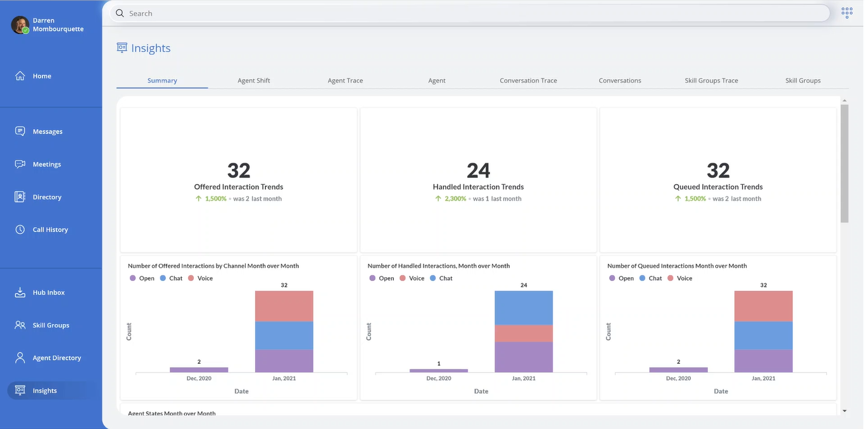
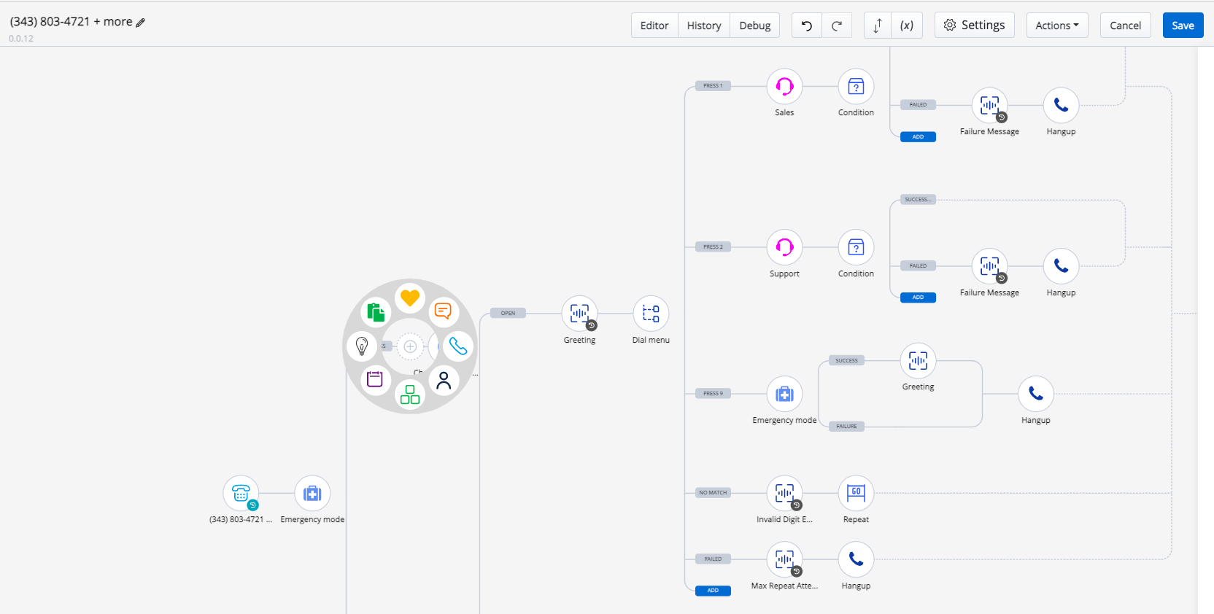
What is Mitel One CX?
Mitel’s cloud native
Contact Center-as-a-Service solution for workgroup and contact center customers!
Seamless Experience
Single interface for Phone, Messaging, Meetings and CX
“Hub” centralizes all customers interactions
Easy Deployment
Deploy, configure and design in minutes
Native cloud with full integration into Mitel service delivery
Powerful, Yet Simple
Visual workflow designer
Voice, chat, SMS, social messaging, and open media
Out-of-the-box and custom integrations and screen pops
Notes:
Mitel One provides users with a seamless experience by combining phone, messaging, meetings, and customer experience features all in one simple to use interface.
Mitel One is also a native cloud application with administration and configuration tools that allow you to deploy and design customer interaction workflows in minutes.
Mitel One is also extremely powerful yet very simple to use with a visual workflow designer to develop workflows with voice, chat, SMS, social messaging, and even open media interactions. It also comes with out-of-the-box integrations with the world’s most popular CRM systems as well as custom integrations for more sophisticated environments.

Slide 14




Pure Cloud UCaaS/CCaaS
Getting Started
Easily quote, order, activate, and provision
Enable new customers in minutes and get interactions flowing immediately
Drag-and-drop visual programming interface
Integrate to commonly used CRMs in clicks, not code
Cloud Flexibility, Scale, and Continuity
Increase scale of operations without complex IT requirements
Built on Amazon Web Services (AWS) and Mitel’s CloudLink infrastructure
Enterprise level uptime, stability, multi layered security and personal data protection and privacy
Simplified Subscription Packaging
Two subscription levels tailored to customer requirement:
  CX Essentials: for customer care environments
  CX Premier: for contact center environments
Bundled business value for MiCloud Connect, Flex, and Mitel One for on-site subscribers
Effortless Deployment and Upgrades
Effortless Upgrades
Reduced IT Infrastructure
Easily connect to Mitel cloud and on-site platforms
Access new CX capabilities with no hardware or software
Get exciting new features as they become available
Notes:
Getting Started
Easily quote, order, activate, and simple provisioning to ignite exceptional customer experiences
Enable new customers in minutes and get interactions flowing immediately using Quick Setup tools
Drag-and-drop visual programming interface for all customer routing configuration
Integrate to commonly used CRMs in clicks not code
Cloud Flexibility, Scale, and Continuity
Increase the scale of your operations without needing to think through complex IT requirements
Built on the market leading Amazon Web Services (AWS) platform and Mitel’s CloudLink infrastructure
Delivered with enterprise level uptime stability, multi layered security and personal data protection and privacy
Simplified Subscription Packaging
Two subscription levels tailored to customer requirement:
CX Essentials: for customer care environments
CX Premier: for contact center environments
Bundled business value for MiCloud Connect, Flex, and Mitel One subscribers who automatically get CX Essentials licensing in the Premier & Elite subscription levels
Effortless Deployment and Upgrades
SaaS Benefits: Effortless Upgrades / reduced IT Infrastructure
Easily connect to Mitel public/private cloud and on-site platforms
Access new CX capabilities with no additional hardware or software
Get exciting new features as they become available

Slide 15




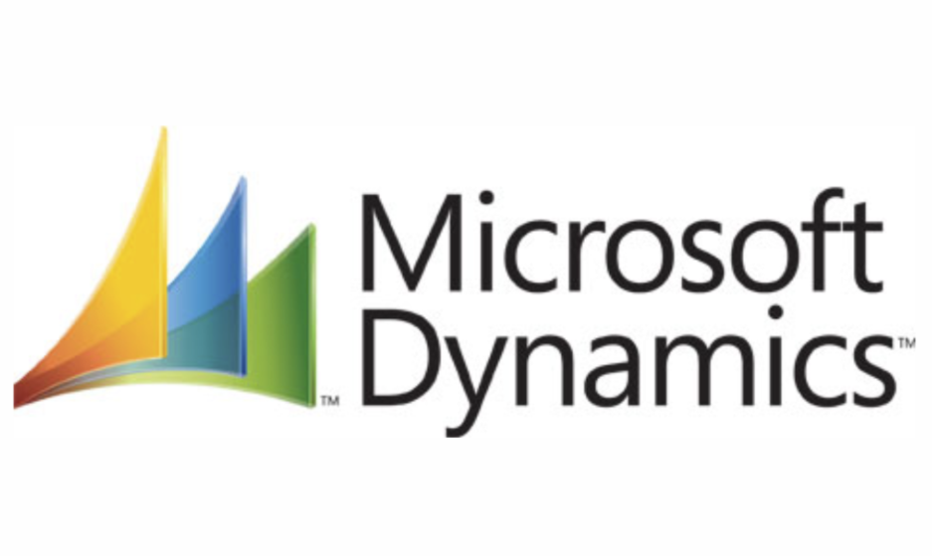



INTEGRATE WITH EASE TO THE WORLD’S MOST POPULAR APPS
Mitel
One
Notes:
Integrations are key to any modern SaaS application.. every modern company has multiple SaaS solutions included in their business processes.
Mitel is bringing SaaS integrations to the forefront.. ensuring our solutions can work with your business processes
Our Mitel One CX v1 is coming out of the gate with 8 first class integrations.. and more to come later. Don't see an integration you need we have a model to work with services and roll-your own. You are not locked in.
Remember last year when we showed that custom designer product in our innovation labs center? We listened to your feedback.. and built that technology directly into our Mitel One CX. All that power of customizing your customer experiences.. need a simple auto attendant, check, need a powerful IVR, check... how about just some simple custom messaging, check. If you have a phone number.. you'll want this :)
Twilio – Messenger & SMS
Salesforce – Case & Customer Management, Screen Pop
Microsoft Dynamics - Case & Customer Management, Screen Pop
Microsoft – Authentication & Directory
WhatsApp – Messenger & Chat
Zendesk - Case & Customer Management, Screen Pop
Google G-Suite – Authentication & Directory
Facebook – Messenger & Chat

Slide 16
Integrate with Clicks, Not Code
Notes:
Integrations are key to any modern SaaS application.. every modern company has multiple SaaS solutions included in their business processes.
Mitel is bringing SaaS integrations to the forefront.. ensuring our solutions can work with your business processes
Our Mitel One CX v1 is coming out of the gate with 8 first class integrations.. and more to come later. Don't see an integration you need we have a model to work with services and roll-your own. You are not locked in.
Remember last year when we showed that custom designer product in our innovation labs center? We listened to your feedback.. and built that technology directly into our Mitel One CX. All that power of customizing your customer experiences.. need a simple auto attendant, check, need a powerful IVR, check... how about just some simple custom messaging, check. If you have a phone number.. you'll want this :)
Twilio – Messenger & SMS
Salesforce – Case & Customer Management, Screen Pop
Microsoft Dynamics - Case & Customer Management, Screen Pop
Microsoft – Authentication & Directory
WhatsApp – Messenger & Chat
Zendesk - Case & Customer Management, Screen Pop
Google G-Suite – Authentication & Directory
Facebook – Messenger & Chat

Slide 17
Mitel Revolution
Mass notification

Slide 18
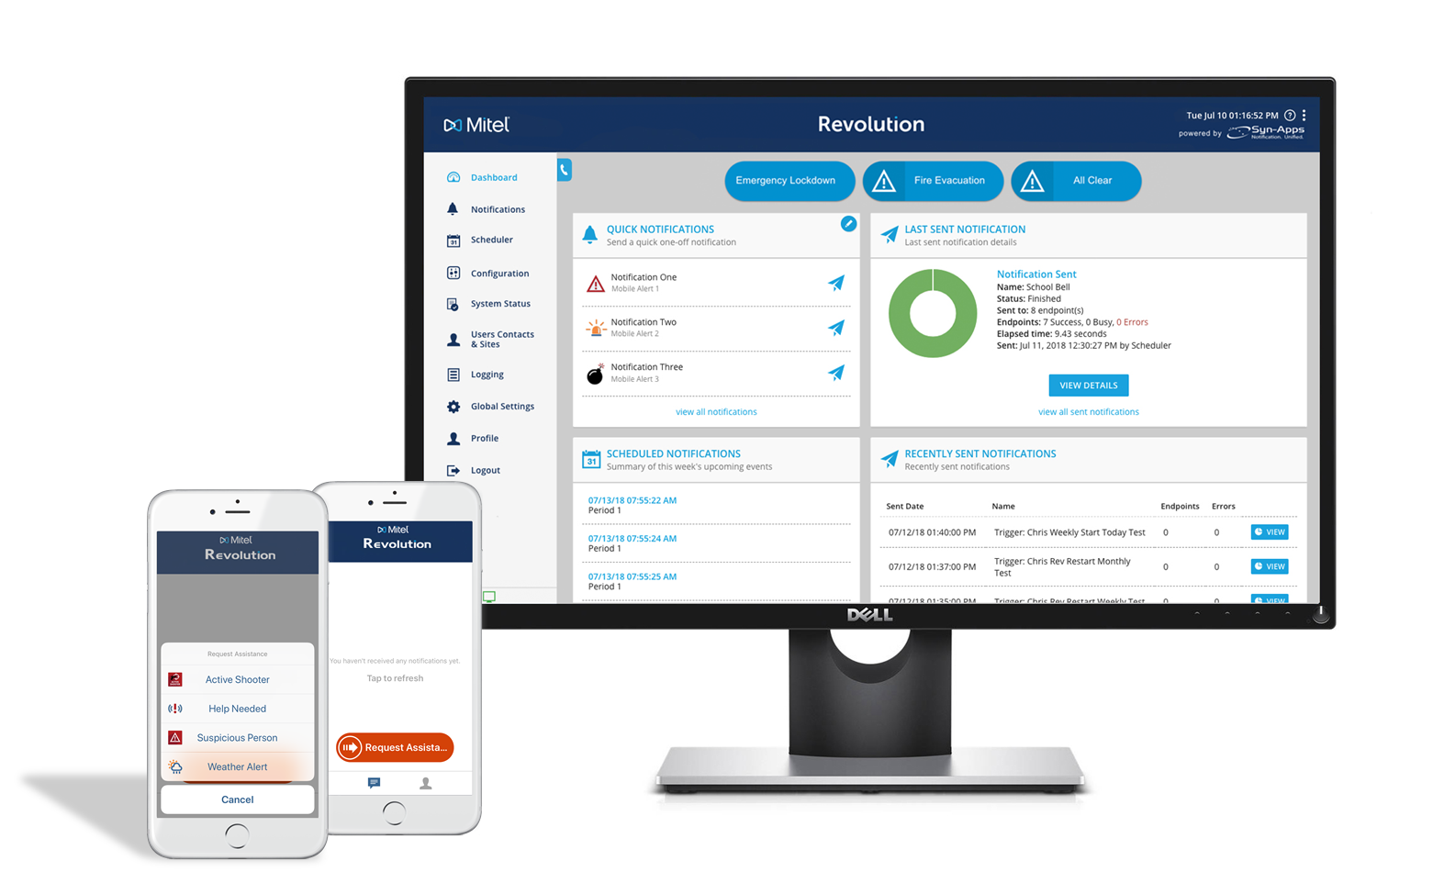
Wat Is Mitel Revolution?
Mitel Revolution is een mass notification applicatie op basis van OPEX model!

Slide 19


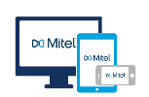
Mitel Revolution: Wat is het?
Multimedia Mass Notification
Noodwaarschuwingen
Eenvoudig beheer
Automatisch getriggerde en on-demand meldingen via live of vooraf opgenomen opname van audio, tekst en foto’s
Meldingen verzenden via overhead paging, spraakgestuurd bellen, e-mail, SMS, Revolution-clients, REST API, enz.
Meerdere endpoints, waaronder IP-telefoons, Revolution-clients, mobiele apparaten, luidsprekers/hoorns boven het hoofd, digitale borden, enz.
Real-time bewaking van noodsituaties zoals 911 of andere noodoproepen, CAP-waarschuwingen (weer, geologisch, oranje waarschuwingen, enz.) en IoT-apparaten (paniekknoppen, omgevingssensoren, enz.)
Geef tijdens noodgevallen tijdgevoelige informatie door aan meerdere contactpersonen met behulp van de meest geschikte mediatype(n)
Meldingen activeren/ontvangen in omgeving met behulp van mobiele client, spraakoproepen, e-mail, enz.
Maak direct telefonische vergaderingen of integreer deze met MiTeam van Mitel Vergaderingen voor volledige audio-, video- en websamenwerking in noodsituaties.
eenvoudig verdelen van groepen op basis van Site, Location, User Tags (bijv. Security (beveiliging), Admin (beheerder), System Tags (systeemlabels) (bijv. apparaattype, fabrikant, IP-adres) of andere endpointkenmerken
Relevante informatie ontvangen op basis van locatie.
Op rollen gebaseerd beleid biedt verschillende toegangsniveaus voor het maken, beheren en verzenden van meldingen.

Slide 20


















Mitel Revolution: Hoe werkt het?
TRIGGERS (activators)
NOTIFICATIES (notifications)
BESTEMMING (notifiers)
RESPONSES
Alarmbellen
Schoolbel
Aankondigingen
Weer alarm
Amber Alerts
Pauze notificatie
Brandoefeningen
Meeting alarm
In-store Paging
Request voor hulp
Deur Open / sluit Alerts
Deur sluiting
Verdachte activiteiten signaal
En meer…
Desktop Clients
Mobile Clients
Emails
IP & SIP Telefonie
IP Speakers, Analoge Paging
SMS Text berichten
Strobes, Beacons, etc.
Uitbellen meerdere telefoons
CAP & XML Feeds
Wandborden en displays.
Desktop Clients
Mobile Clients
IP & SIP Phones
IP Speakers
IP & SIP Phones
External Phone Numbers
Mitel MiTeam Meetings
Bel specifiek nummer
Zenden vanaf revolution (web)client
Via Email
Scheduled event
Press a button, open a door, etc.
Mobile app trigger / Panic button
CAP alarm ontvangen
TWO-WAY AUDIO
CONFERENCE CALLS

Slide 21
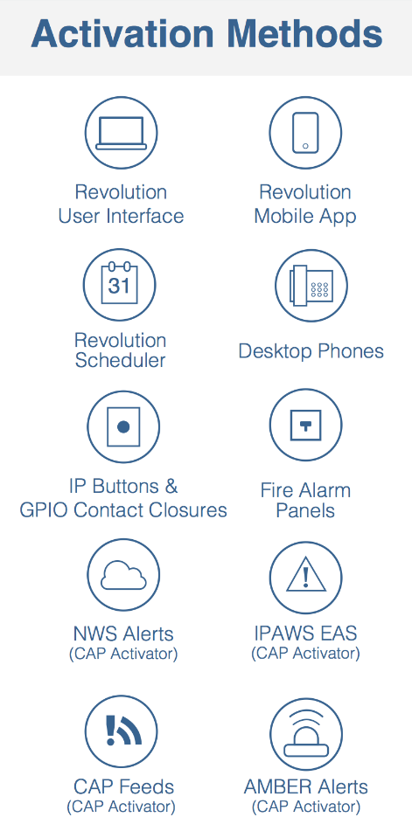
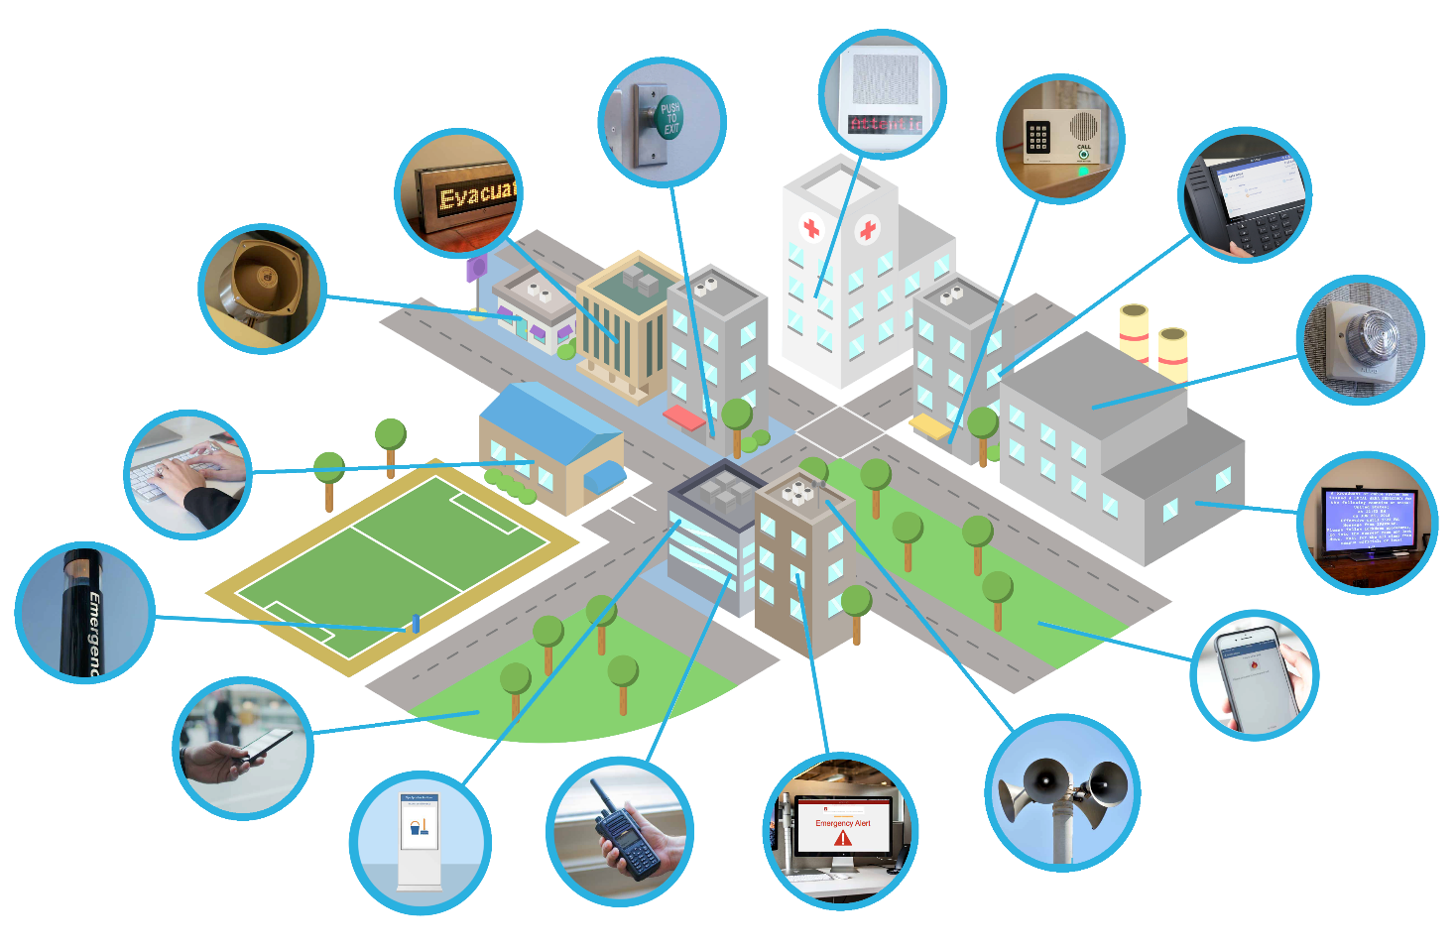
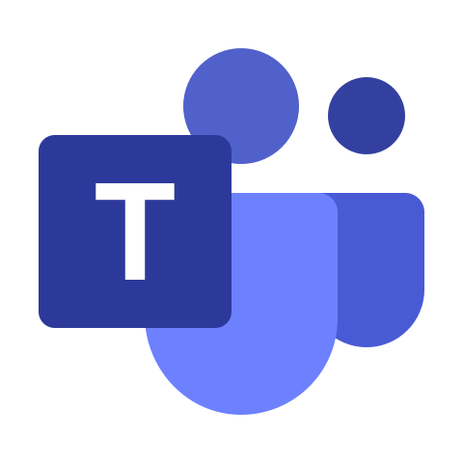
Mitel Revolution:
Vele mogelijkheden van activeringsmethoden en devices om te waarschuwen
API/SIP/HTTP(s) Multicast Audio
Paging Relay
IP Speakers /
PA Systems
FXS/FXO/SIP
General Purpose I/O (GPIO) Contact Closures
Gate/Door Entry Buttons
HTTP(S)
LED Displays
API (XML/PAPI)
Multicast audio
SNMP
IP Phones
FXS/FXO/600ohm
Analog Systems
Strobes & Beacons
HTTP(S)
SMTP
Email Alerts
CCTV Override
CAP
Analog/SIP
Emergency Phones
Mobile Devices
Syn-Apps
SMS Messaging
Alarmering en detectie naar PBX
Twilio
Outdoor Loudspeakers
Digital Signs
Mobile Radio
Desktop Notifications
HTTP(S)
Paging Relay
Contact Closure
Syn-Apps
FXS/SIP/API
Paging Relay
Notes:
Uitleg geven. Niet alle punten benoemen

Slide 22
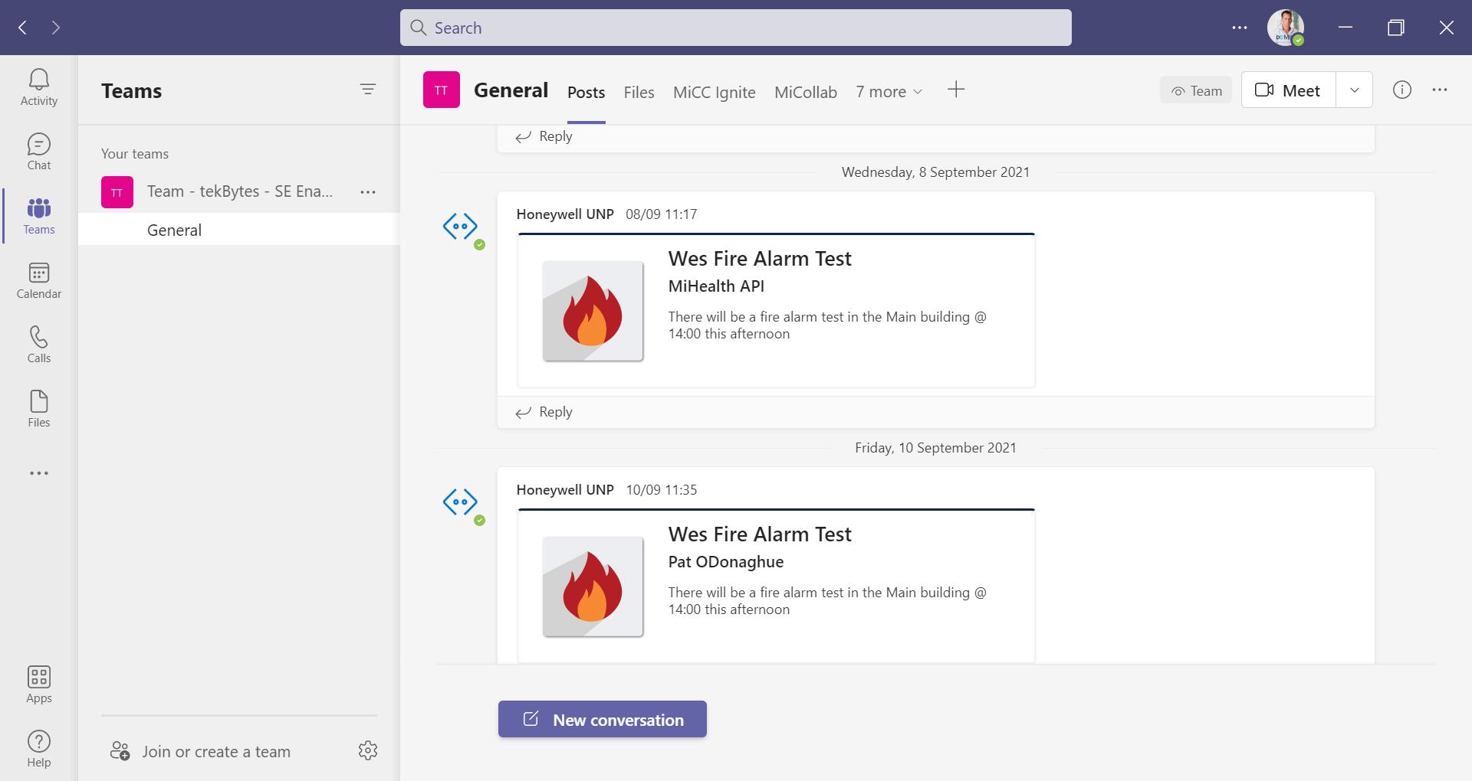

Microsoft Teams
Notificaties eenvoudig te zenden naar MS Teams

Slide 23
Mitel
en Microsoft Teams

Slide 24





Mitel + Microsoft: A Winning Combination
Personal Productivity Tools
Information creation with PCs
Microsoft
Document Tools
Personal Process
Collaboration Tools
Collaboration from anywhere with everyone
Video/Meetings
Messaging
Team Collaboration
Telephony Tools
Communication with mobility
PBX Features
Mitel
PSTN Access
Mobility
Notes:
Microsoft history of expertise starts in productivity and then extends into collaboration and telephony
Mitel history of expertise starts in telephony and then extends into collaboration and telephony.
Being able to offer customer the ability to have both makes Mitel+Microsoft a winning combination.

Slide 25
Mitel with Microsoft Teams Integrations
Integrations | MiVoice Business | MiCloud Flex | MiVoice Connect | MiCloud Connect | MiVoice MX-ONE | MiVoice 5000 | MiVoice Office 400
Direct Routing (SBC-SBC) MSA Certified Session Border Controller | ü | ü | ü |  | ü | ü | ü
Hotkey Dialing Select a phone number in MS Teams and use the hotkey combination to initiate a call | ü | ü | ü | ü | ü | ü | ü
Call2Teams (3rd Party) Integrates any Mitel phone system with Office 365 enabling the Calls feature within Microsoft Teams. | ü | ü |  | Coming soon | ü |  | ü
Web Dialer / Extension Within the MS Teams web user interface, you can click to dial a number. | ü | ü | ü | ü | ü | ü | ü
Mitel Assistant Download the Mitel Assistant in the MS Teams store to launch MiTeam Meetings | ü | ü | ü | ü | ü | ü | ü

Slide 26


Consolideren van toolsets
Vandaag de dag steeds meer tools en apps waardoor het onoverzichtelijk wordt.
Daarom Mitel en MS TEAMS samenvoegen!
Mitel:
  Mission-critical communications
  Keuze uit endpoints: desk, softphone, mobile onder het zelfde nummer
  Uitgebreide voicemail mogelijkheden apart van email en visual voicemail
  Real-time, rijke presence and beschikbaarheid functionaliteiten
  Ring Group control
  Active Directory sync / SSO
  Calendar synchronisatie
  Contact center
  Integratie met kalender
Microsoft Teams:
  Video (Personal, Room, Internal / External)
  Document Sharing and Collaboration (particularly if they are Office365)
  Non Real Time Chat (1:1 or 1:Many Chats and Internal Forum / Posting type messaging)
Microsoft Outlook:
  Email
  Kalendar
  Directory (Personal, Corporate)
  Integratie met kalender
Notes:
Having too many tools creates complexity that companies don’t need. By combining Mitel and Microsoft you’ll get the benefits of a true communications solution, plus the productivity tools that come with Microsoft Teams and Outlook.

Slide 27
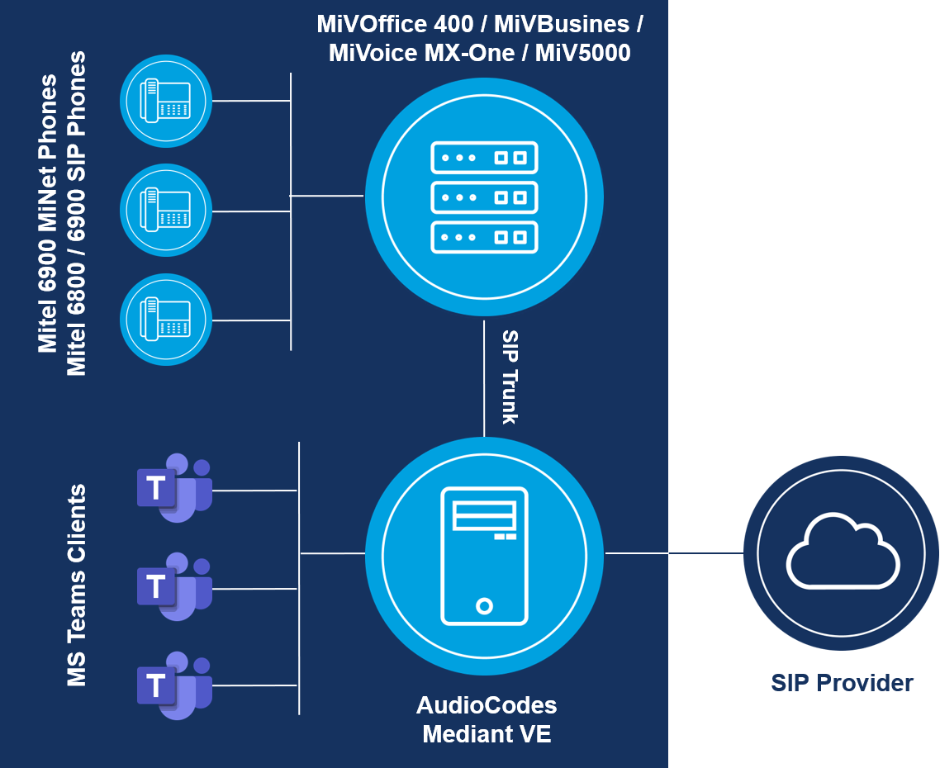

Direct Routing - Mitel, MS Teams and AudioCodes
  Connect complete Mitel telephony infrastructure to Microsoft Teams with a certified Session Border Controller.
  With Session Border Controller (SBC)
  AudioCodes Mediant
  Virtual Edition (VE) 7.20A.252.011
Option:
SIP-trunk connection between MiVoice PBX via
SBC* to MS Teams
Routing plan configured in PBX
Full telephony integration in MS Teams including
dialing from contact cards, escalate from chat etc.
No Mitel software or apps involved; customer keeps full control of PTSN and billing
Limitations:
Full Microsoft licenses needed
Certified SBC needed
*Direct Routing certifications have been performed using the AudioCodes Mediant SBC (common firmware/support for Mediant 500L/500/800/1000/ CloudBond 365)
See interop information on InfoChannel: MSA > Certified Applications > Other Applications
Notes:
Im InfoChannel Mitel Solutions Alliance
finden Sie unter Certified Applications / Other Applications / Microsoft:
Teams Collaboration Application for MiVoice Business, MiVoice MX-ONE, MiVoice 5000, MiVoice Connect & MiVoice Office 400
je Mitel Kommunikationssystem diverse Dokumente, wie
Testbericht mit Konfigurationsanleitung sowie
AudioCodes Profile und teilweise
SIP Peer Profile
https://infochannel.mitel.com/ICMSA/qnprod.nsf/

Slide 28
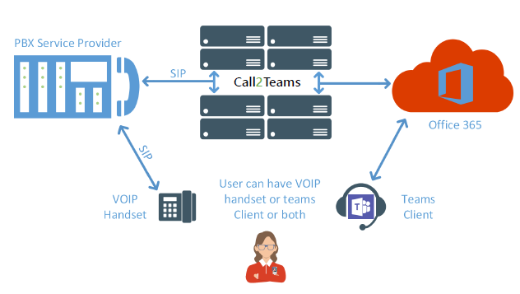
Call2Teams
Zet gesprekken op of ontvang deze vanuit teams vanuit IOS en android devices. Voeg eenvoudig video toe.
PSTN connectiviteit eenvoudig vanuit uw bestaande Mitel omgeving
Samenwerken en spraak tezamen Call2teams zorgt ervoor dat gebruikers waar zij dat ook willen hun gesprekken op kunnen zetten.
Call2Teams registreert een teamsclient als een SIP-device op de bestaande Mitel omgeving.

Slide 29
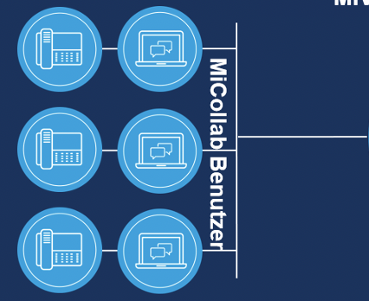



Call2Teams
MiVoice Business
Public Cloud
Call2Teams
Audiocodes Gateway
Teleworker Extension (SIP)
MBG
Teams API Integration
Could be subject to change

Slide 30

Voordelen van integratie met Call2Teams
Behoud van alle functionaliteit die Mitel te bieden heeft; hotdesk users, hunt groups, call flows, auto Attendants etc.
Geen hardware/software benodigd
Geen extra onderhoud of support benodigd
Meerdere keuzes van devices/terminals per gebruiker
Gebruik van native Teams client voor uitgaande en inkomende gesprekken
Geen extra Microsoft calling plans (phone systems op e1 en e3)

Slide 31
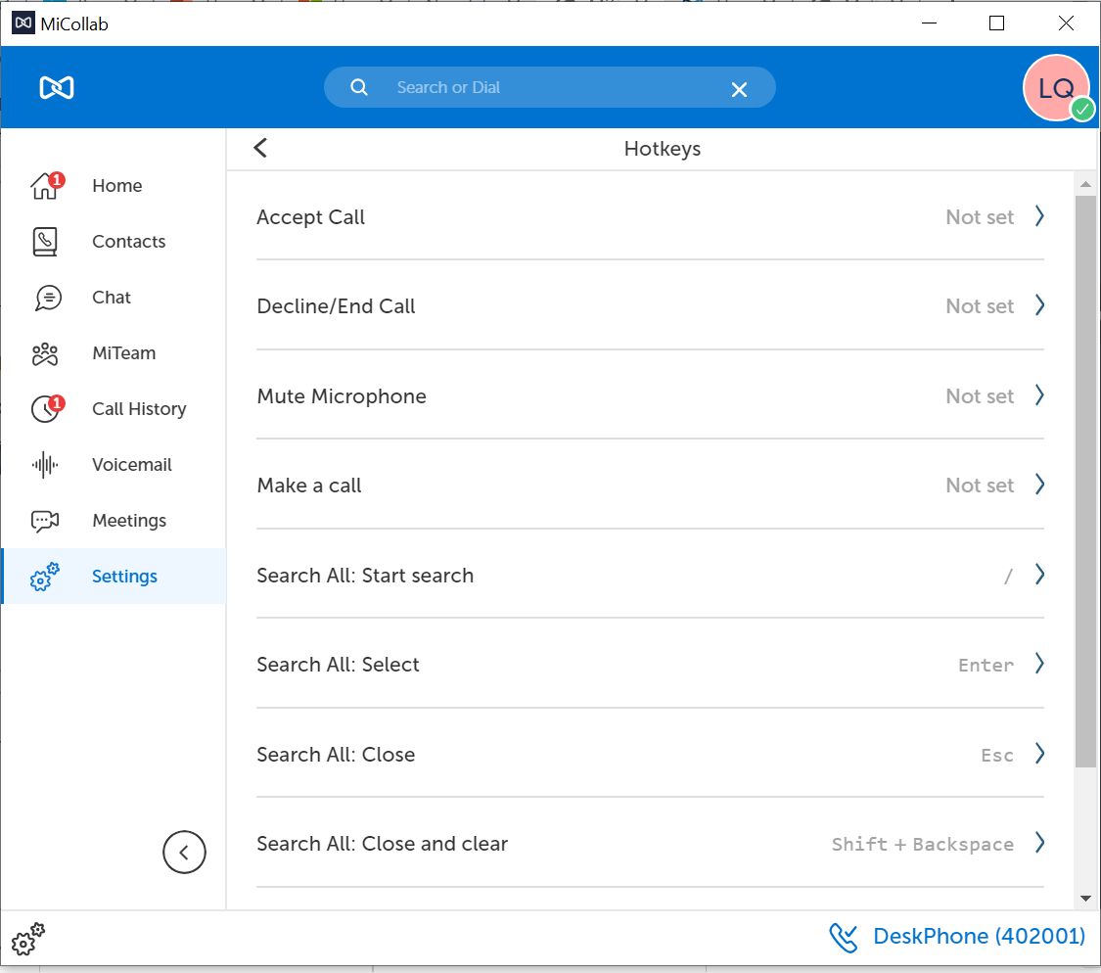
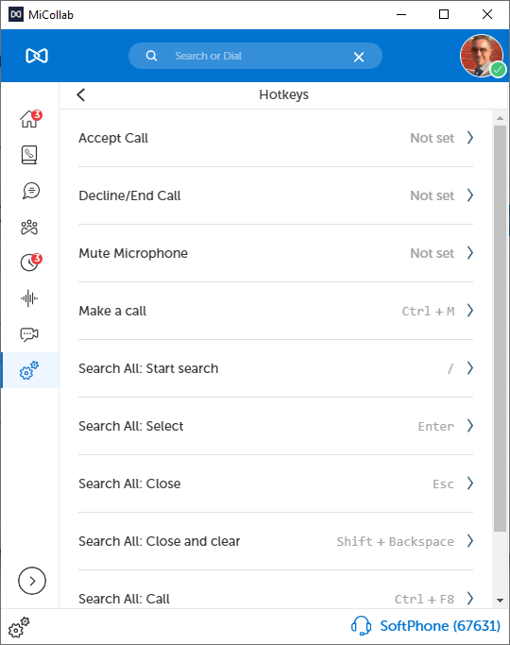
Connect and MiCollab Hotkeys
MS Teams Desktop + Hotkeys

Slide 32
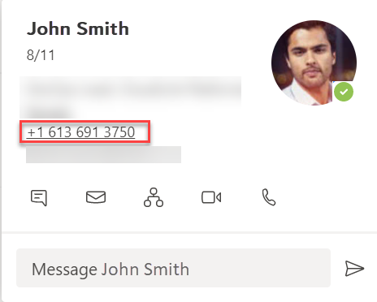
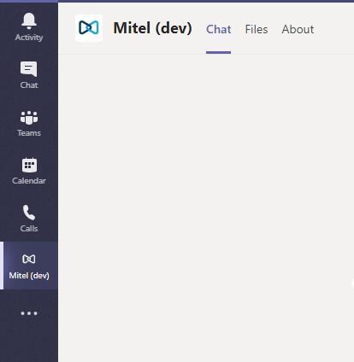
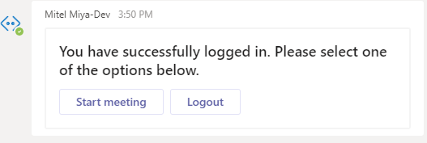
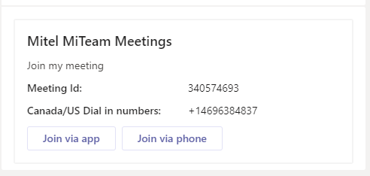
Teams Client integration
Mitel Web Extension
  MS Teams users can:
    Click on a phone number in MS Teams to place. Mitel softphone will be cross launched
    Answer inbound calls in the Mitel softphone (independent form MS Teams client)
  Eligible to customers with one of the following
    MiCollab UCC Entry (CTI call control only)
    MiCollab UCC Standard (+SIP Softphone)
    MiCollab for Microsoft uplift
Mitel Assistant (MS Teams bot)
  MS Teams users can:
    Initiate MiTeam Meetings sessions from within MS Teams client
    Join MiTeam Meetings sessions from MS Teams client
  Eligible to customers with
    MiTeam Meetings subscription
Mitel

